Slide 1
News Research tools:
Automated news summarization for equity research
Built with Groq Ai , NewsApi and streamlit
Real time insights from latest news.
Date : 24/06/2025
Meet patel

Slide 2
Challenges in Financial news research:
Information overload from multiple news sources
Time consuming manual analysis of articles
Difficulty in extracting key insights quickly
Need for real time market intelligence

Slide 3
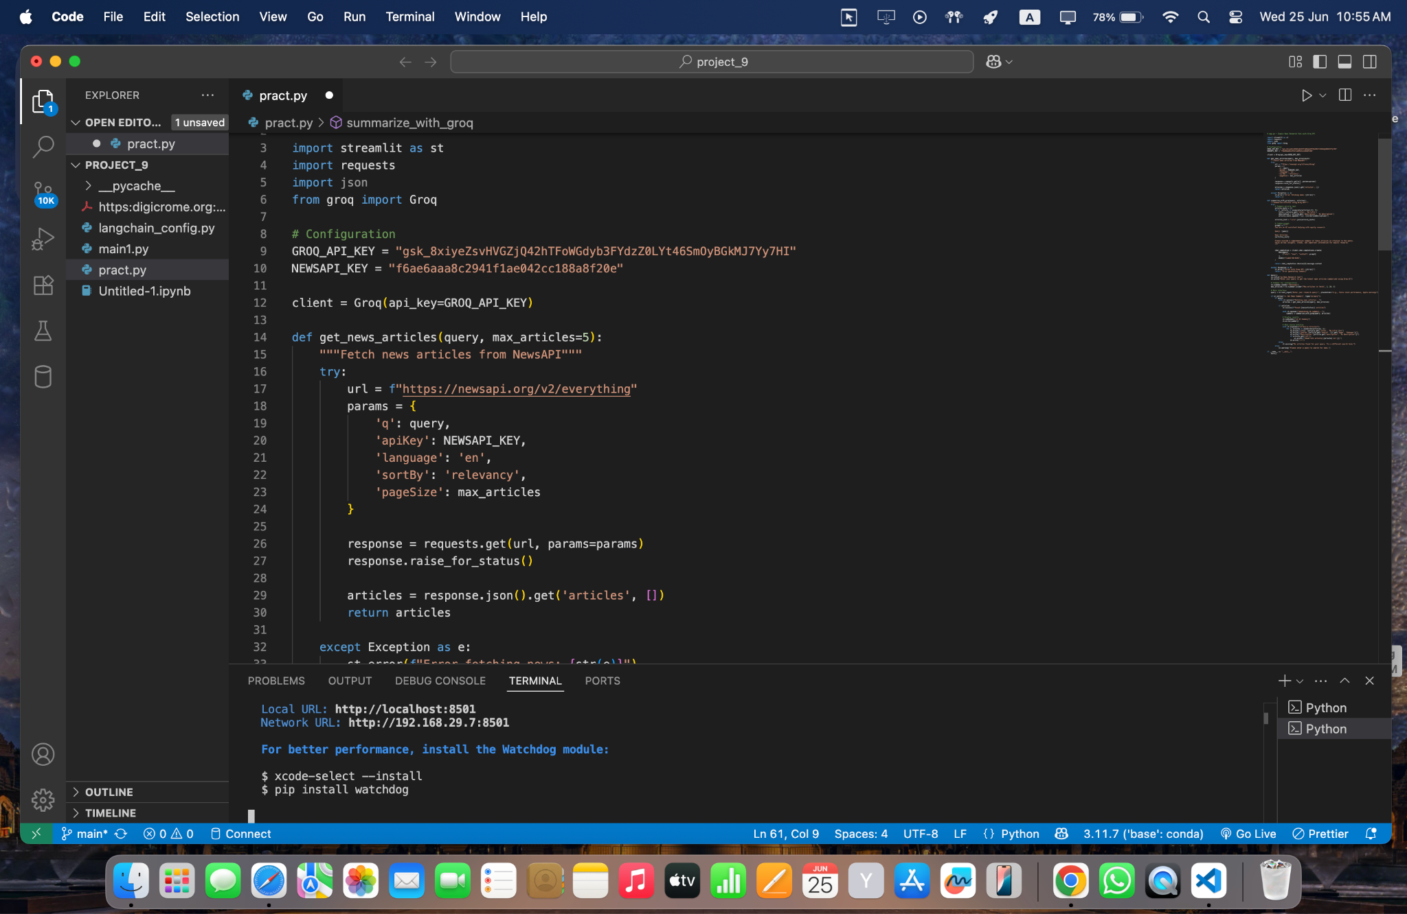
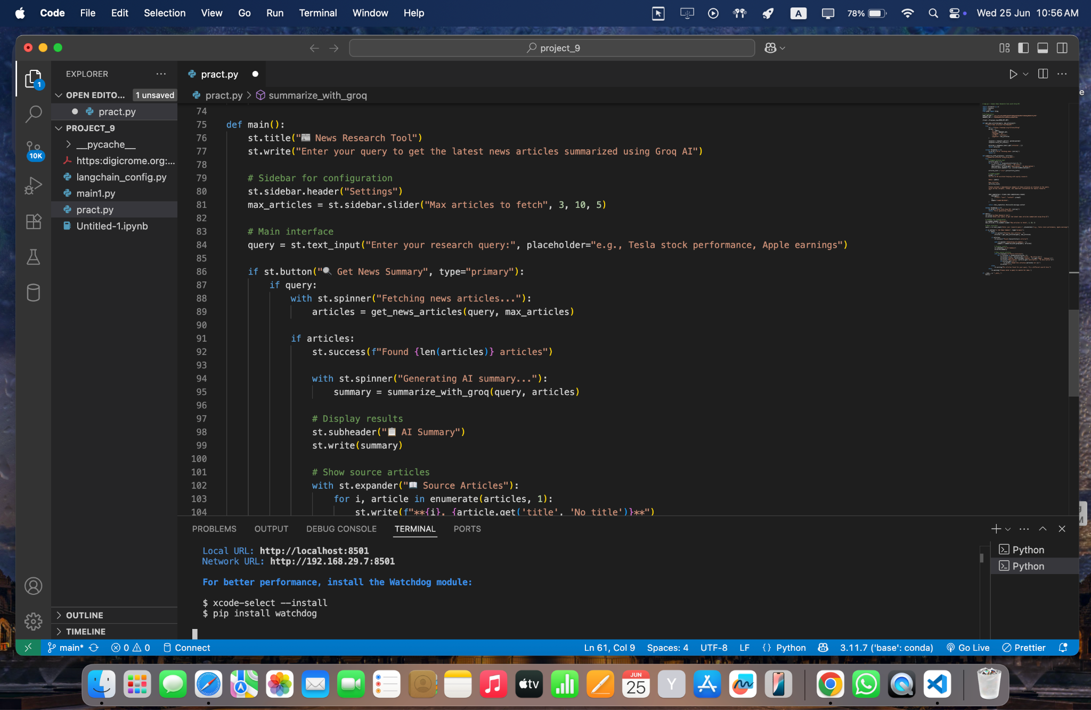
Here it is a code for news research tool:

Slide 4
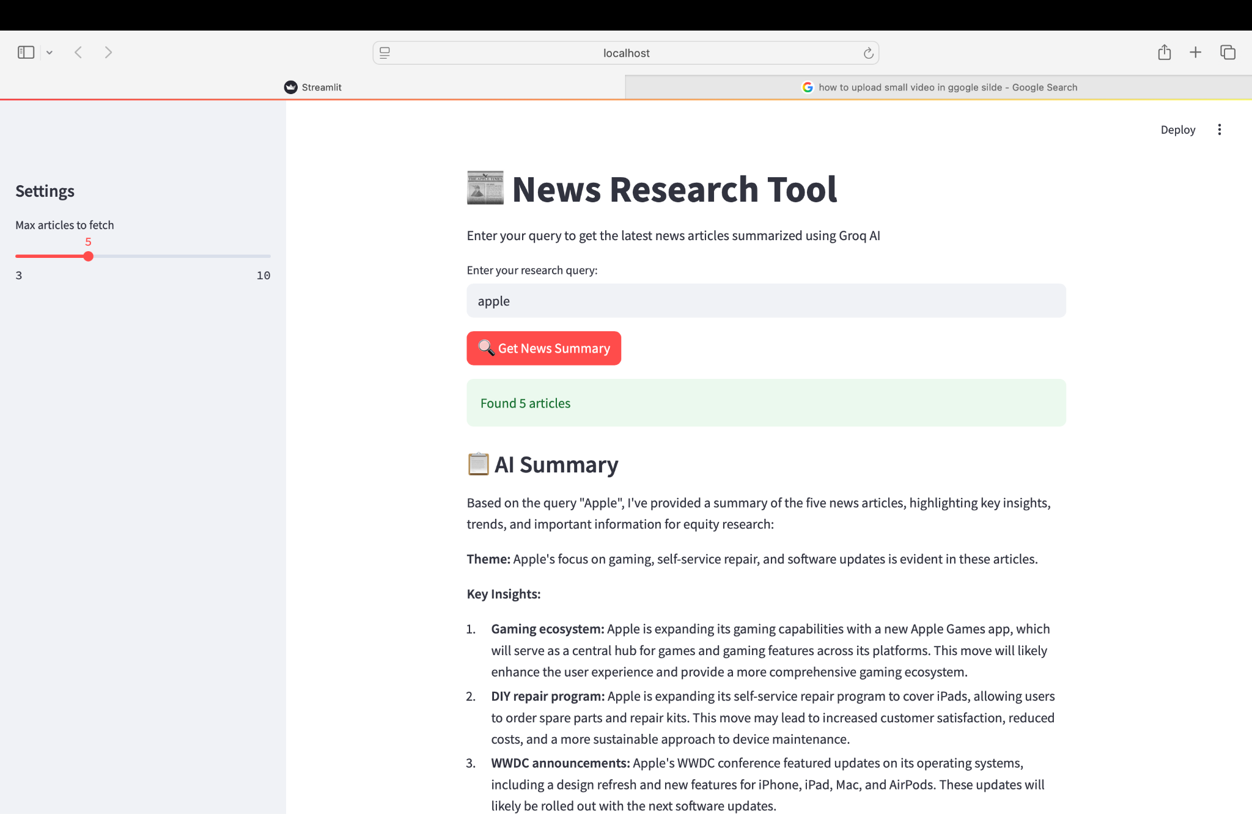
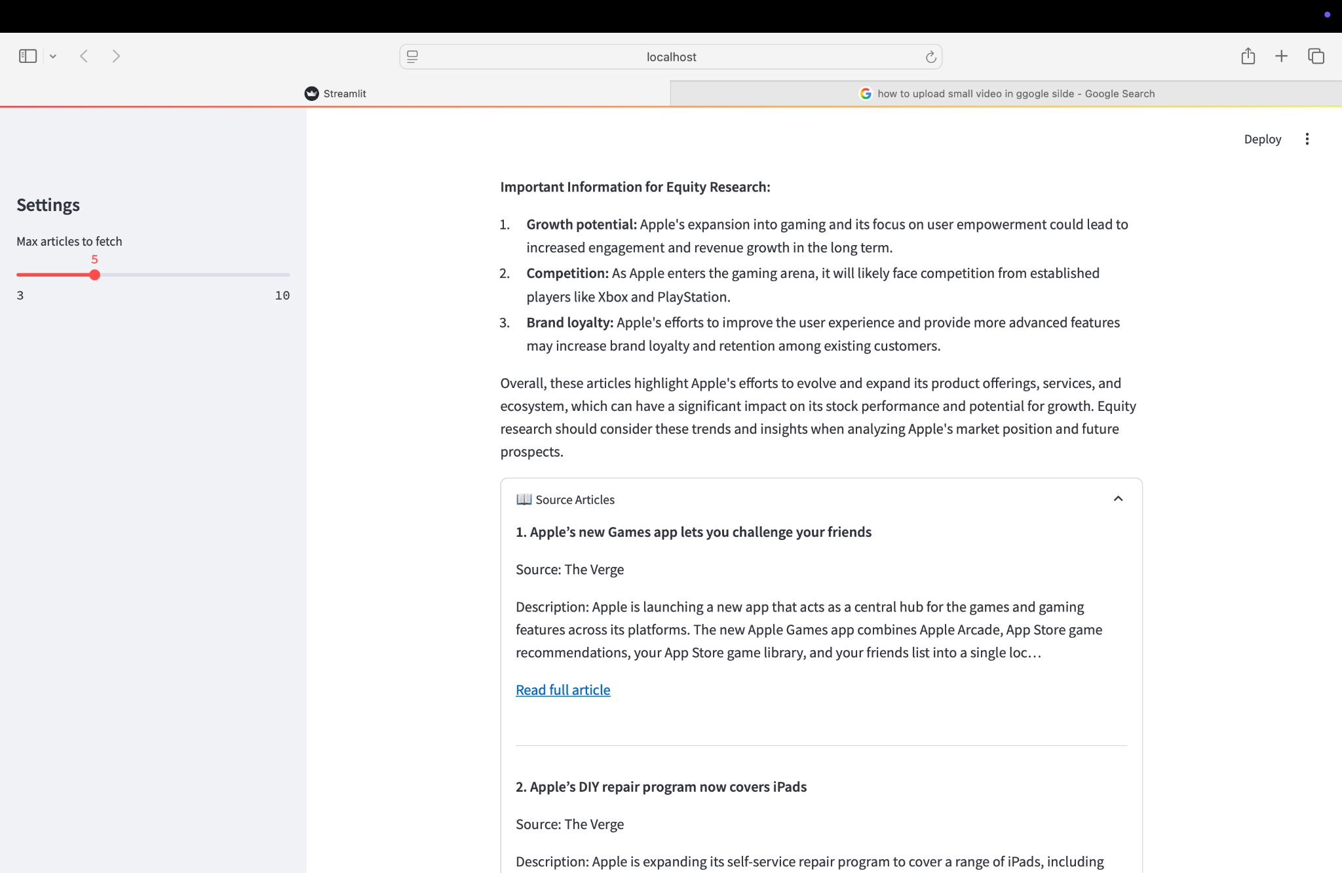
News research tool:

Slide 5
Technology stack:
Core technology used:
Frontend: Streamlit
AI Engine: Groq API
News Source: NewsAPI (Real-time news data)
Language: Python 3.8+
Deployment: Local/Cloud compatible

Slide 6
How it work:
User Input: Research query entered
News Fetching: NewsAPI retrieves relevant articles
AI Processing: Groq AI analyzes and summarizes
Results Display: Summary + source articles shown
User Action: Review insights and access sources

Slide 7
Thank you

